Slide 1

Reporting Guidelines for Music-Based Interventions: Improving Quality and Consistency in Whole Health Research
Sheri L. Robb, PhD, MT-BC
Indiana University
Emmeline Edwards, PhD
NCCIH/NIH
David Riley, MD
Erik J. Groessl, PhD
UC San Diego/VA San Diego

Slide 2
Reporting Guidelines for Music-Based Interventions:
Improving Quality & Consistency
Sheri L. Robb, PhD, MT-BC
Walther Professor of Supportive Oncology
Indiana University Schools of Nursing & Medicine
Notes:
To ground our panel session, I will start by sharing information about reporting guidelines, what they are, and why they are important.
Followed by outcomes from a validation study to update the Reporting Guidelines for Music-Based Interventions.

Slide 3





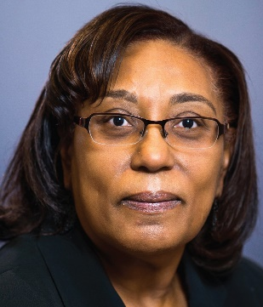










Melita Belgrave, PhD
Arizona State University
Debra Burns, PhD
University of Memphis
Emmeline Edwards, PhD
National Center for
Complementary & Integrative
Health (NCCIH)
Tasha Golden, PhD
University of Florida
Sheri Robb, PhD
Indiana University
Stacey Springs, PhD
Harvard University
Joke Bradt, PhD
Drexel University
Christian Gold, PhD
University of Vienna;
Norwegian Resource
Center (NORCE)
John Iversen, PhD
McMaster University
Assal Habibi, PhD
University of
Southern California
Julene Johnson, PhD
University of California
San Francisco
Miriam Lense, PhD
Vanderbilt University
Susan Perkins, PhD
Indiana University
Jessica MacLean
Doctoral Student
Indiana University
K. Maya Story, PhD
Indiana University
Veteran’s Affairs HSR & D
Beth Harman, PhD
Postdoctoral Research Scholar
Indiana University
Notes:
I want to first recognize our Expert Panel Members who participated in the Delphi process to update/validate the Reporting Guidelines for Music-Based Interventions.
And who co-authored both the validation study and guidance statement that companions the guidelines.

Slide 4
“Clinical practice and public health policy decisions depend on high-quality information about research findings.”
-Doug Altman
Notes:
Dr. Doug Altman was an English statistician best known for his work that centered on improving the reliability and reporting of medical research.
He played a central role in establishing better standards and guidance for what investigators should include in their published research reports.
In the 1980s Dr. Altman, along with others, began to identify problems and inconsistencies in how research was being reported.

Slide 5
Reporting Quality Matters.
Biased results can mislead decision-making in healthcare at all levels.
1980s Publication Deficiencies
1996 CONSORT Statement
TREND Statement
Complexity of behavioral and non-pharmacological interventions
Notes:
Well-designed, properly executed studies provide the evidence needed to develop and implement health care interventions. However, when published studies do not fully report information about the design and conduct of the trial, the result can be biased findings or exaggerated treatment effects.
Interest in quality of published research reports emerged in the 1980s, with growing awareness about deficiencies in reports of clinical trials. For RCTs, there was a growing number of publications documenting missing and/or inaccurate information.
In 1982, a group of scholars suggested that editors could greatly improve clinical trial reporting by providing authors with a list of items tat should always be reported.
In 1996, the CONSORT statement was published offering a checklist of information that should be reported for Randomized Controlled Trials.
This was followed by the TREND statement for non-randomized trial designs.
It is important to note that both CONSORT and TREND focus on methodological reporting, with one checklist item dedicated to describing the intervention. The instruction being to describe the intervention with enough detail to support replication.
Later publications, called for the development of supplemental guidelines that could offer more specific guidance on what authors should report when describing the intervention.

Slide 6
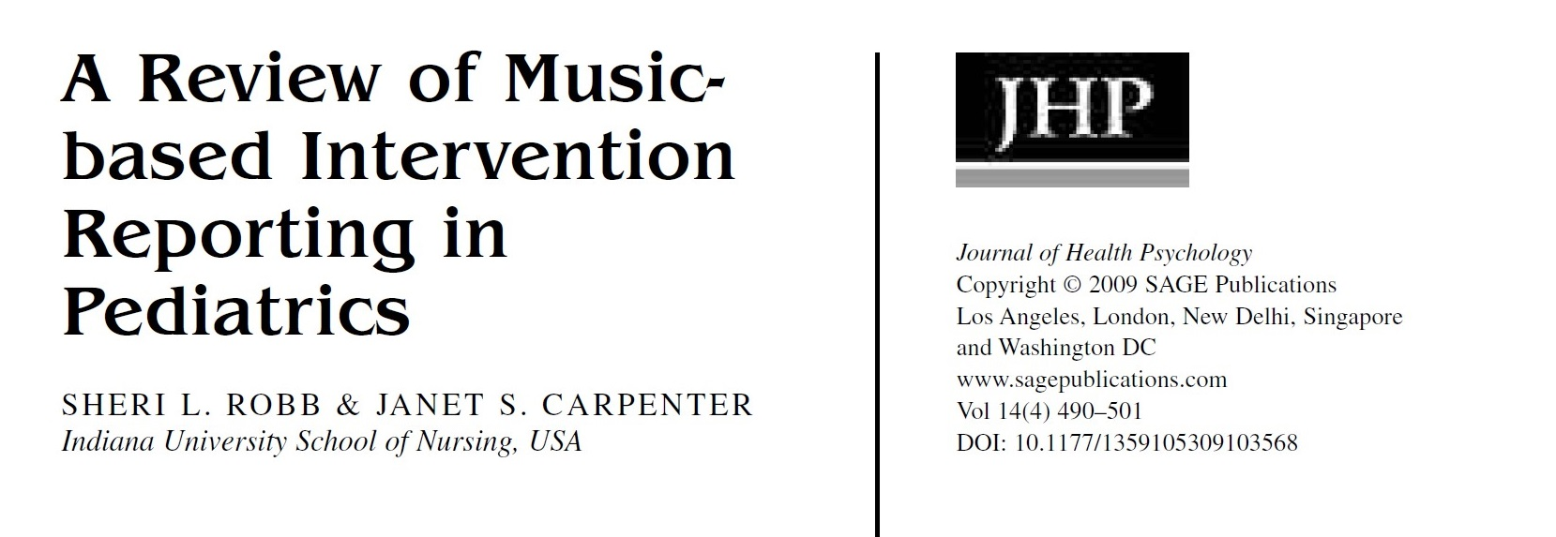
Notes:
Given the growing interest in music for health, and concerns about the lack of specificity in how music interventions are reported, we conducted a large systematic review to identify specific gaps in music intervention reporting.
Music interventions are especially complex and difficult to describe due to the inherent complexity of music itself, and the many ways in which music can be experienced and used for therapeutic benefit.
Consistent with Cochrane reviews, we found a high level of variation in music intervention reporting – supporting the need for reporting guidelines specific to music-based interventions.

Slide 7
A minimum list of information needed to ensure a published manuscript can be:
- understood,
- replicated,
- used to inform clinical decisions
-included in systematic reviews.
Notes:
The Equator Network defines a reporting guideline as a…

Slide 8
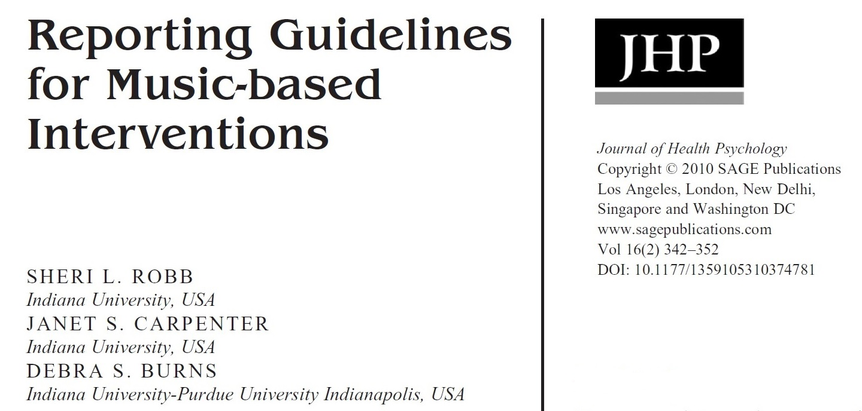

http://www.equator-network.org/
Notes:
In 2011, my colleagues Dr. Debra Burns and Dr. Janet Carpenter, published Reporting Guidelines for Music-Based Interventions.
The guidelines were published open access and available through the Equator Network.

Slide 9
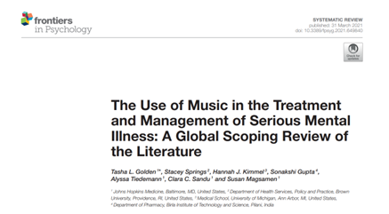
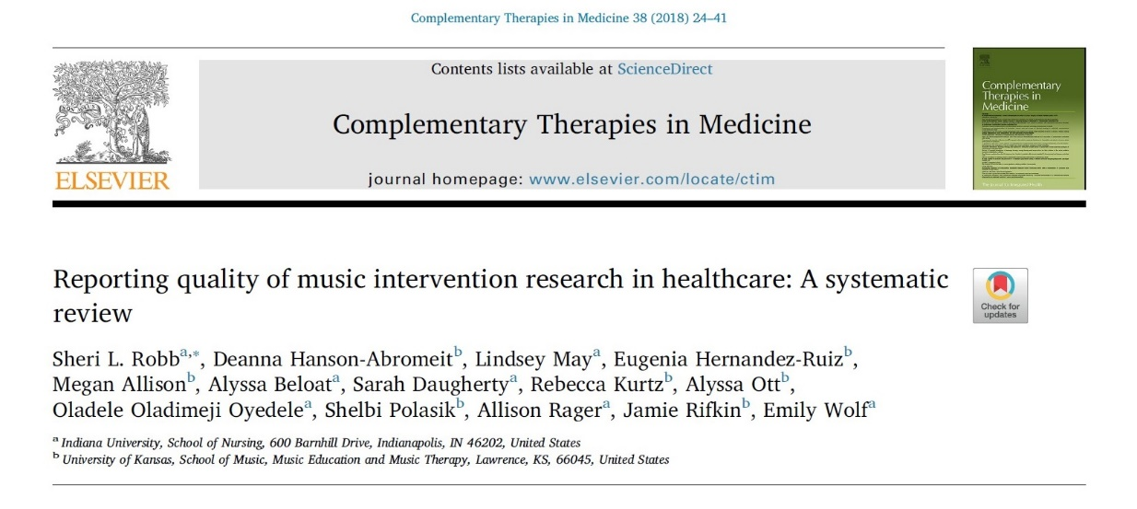
Notes:
Despite growing awareness and availability of the 2011 guidelines, subsequent reviews indicate that reporting quality has remained poor.

Slide 10
To ensure validity of current checklist items and improve uptake we proposed a three-stage process to examine current guidelines and disseminate resulting validated checklist and guidance statements.
Notes:
The original MBI guidelines were developed without the benefit stakeholder – which might explain limited uptake.
To address these limitations and improve uptake we convened an interdisciplinary team to revise and validate the 2011 guidelines using a rigorous Delphi approach.
We also recognized the importance of creating a guidance statement to support use of the newly validated reporting checklist.

Slide 11
Methods Overview
Stage 1: Field Scan
Stage 2: Delphi Survey
Two Rounds + Expert Panel
Stage 3: Dissemination
Funding Support from the Walther Cancer
Foundation.
Notes:
Stage 1 of our three-phase process involved a field scan. Jessica MacLean (a doctoral student at IU) conducted the scan which looked at systematic reviews of music intervention studies published since 2018.
This was done to gather recent information about gaps in reporting quality to inform our Delphi survey process.
Stage 2 – included the Delphi Survey. This included two rounds of surveys, with an expert panel reviewing resulting data to inform item revision.
Stage 3: Publish and Disseminate the revised checklist and Guidance Statement document. We anticipate publication later this Spring across several journals, including Global Advances in Integrative Medicine and Health.

Slide 12
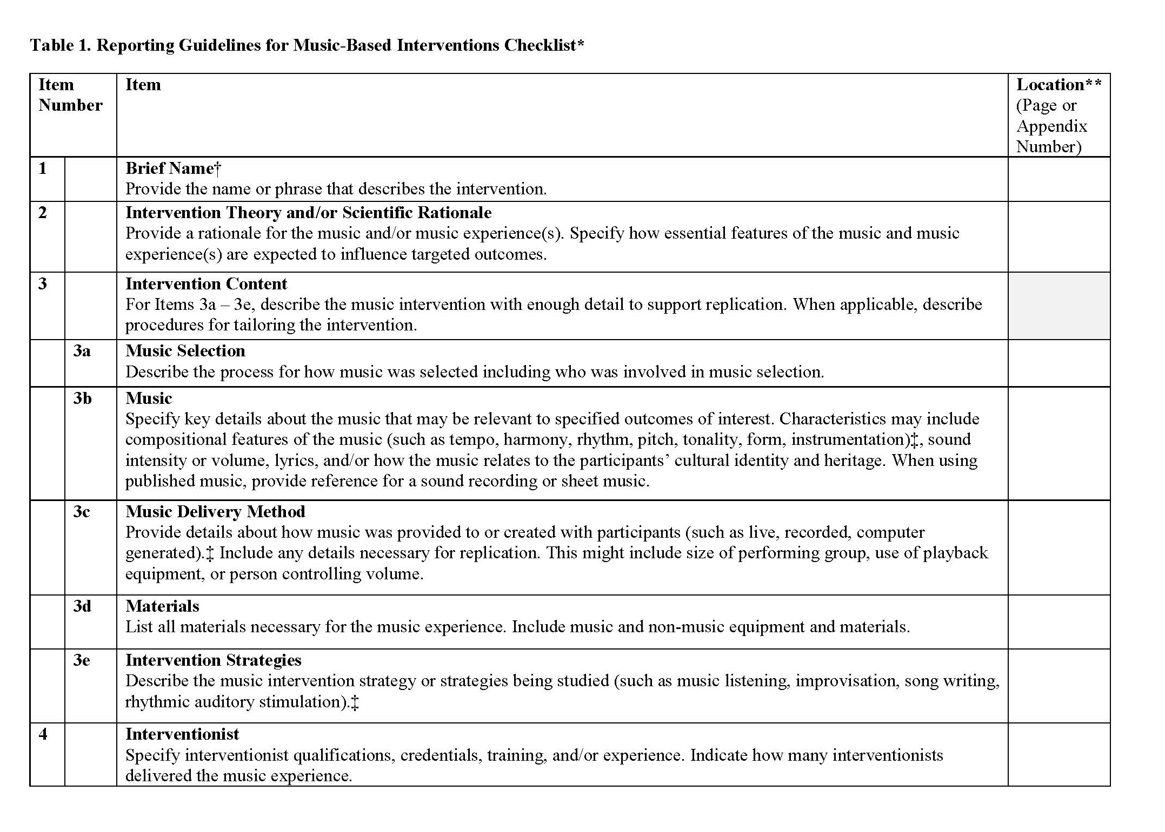
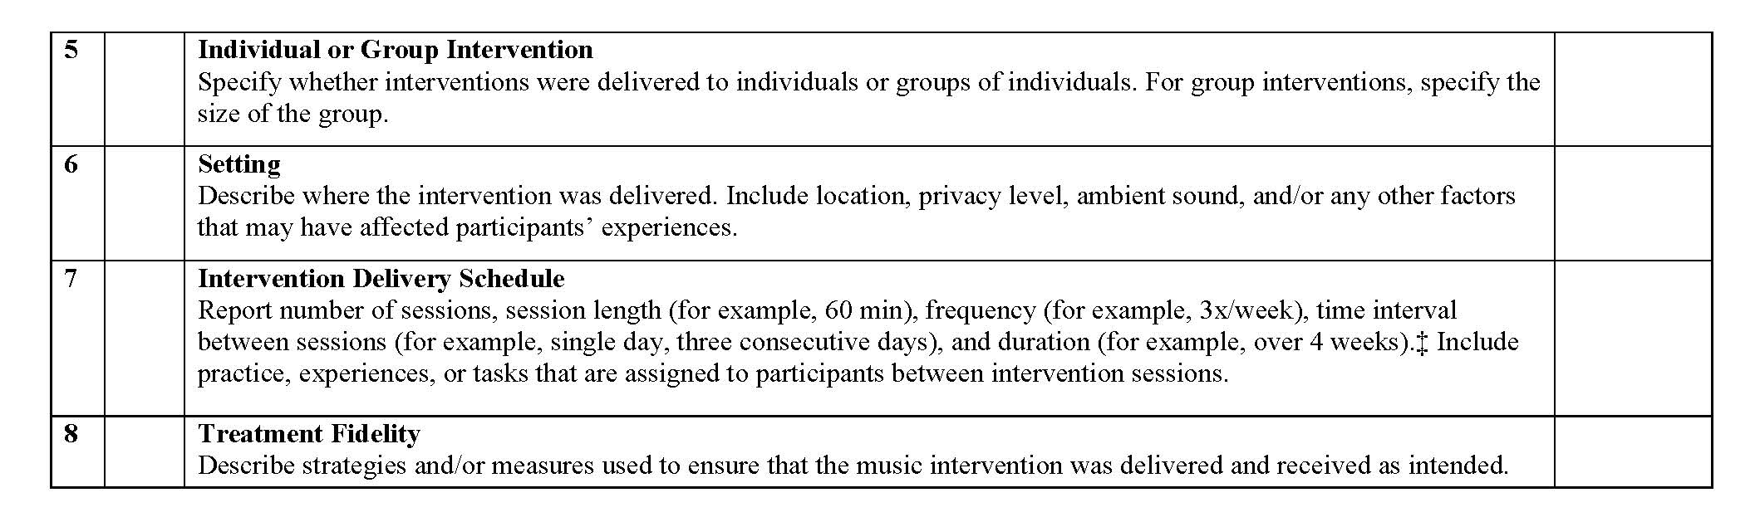
Reporting Guidelines for Music-Based Interventions Checklist
  Brief Name
  Intervention Theory/Scientific Rationale
  Intervention Content
    Music Selection
    Music
    Music Delivery Method
    Materials
    Intervention Strategies
  Interventionist
  Individual or Group
  Setting
  Intervention Delivery Schedule
  Treatment Fidelity
Notes:
The guidelines specify 7 areas for reporting that include…

Slide 13
Focus is on description of the music intervention.
Used in conjunction with methods-specific guidelines.
Notes:
The focus is on the description of the music intervention – and not methodology.
The guidelines are intended to be used in conjunction with methods-specific guidelines like CONSORT, TREND, CARE, or STROBE.

Slide 14
2025 Dissemination Phase
-Validated Checklist & Guidance Statement Published Open Access
-Reprints & Editorials to Expand Reach
-Available through EQUATOR Network
-Author Workshops and Talks
Notes:
As I mentioned earlier, the validated checklist and guidance statement will be published open access, and available this Spring.
We are working to publish reprints and editorials across a range of journals.
Once published, the new guidelines will be available through the EQUATOR network.
And our team will also be working to provide workshops and talks to ensure the work reaches those conducting research in the music and health space.
If you have an interest or need for a workshop at one of your conferences, please let us know.

Slide 15
Synergy Between the NIH MBI Toolkit & the Reporting Guidelines
ICIMH Meeting - March 6, 2025
Emmeline Edwards, Ph.D.
Director, Division of Extramural Research
NCCIH/NIH

Slide 16

Author’s Disclosure
Dr. Edwards is a Title 42 federal employee who is required to disclose all financial holdings as public record and has no outside activities to disclose.

Slide 17
Presentation Outline
Music-based Interventions – the premise
Music-based Interventions – NIH Toolkit
Improvement of MBI Research through broad adoption of MBI Toolkit and Reporting Guidelines

Slide 18

Integration of Arts and Health
Into NIH’s Scientific Priorities
NIH initiatives are representative of burgeoning partnerships related to the impact of the arts on health
Arts and health interface with some key areas of interest at NIH including integrative health, whole person health, and the interconnections of the mind and body

Slide 19
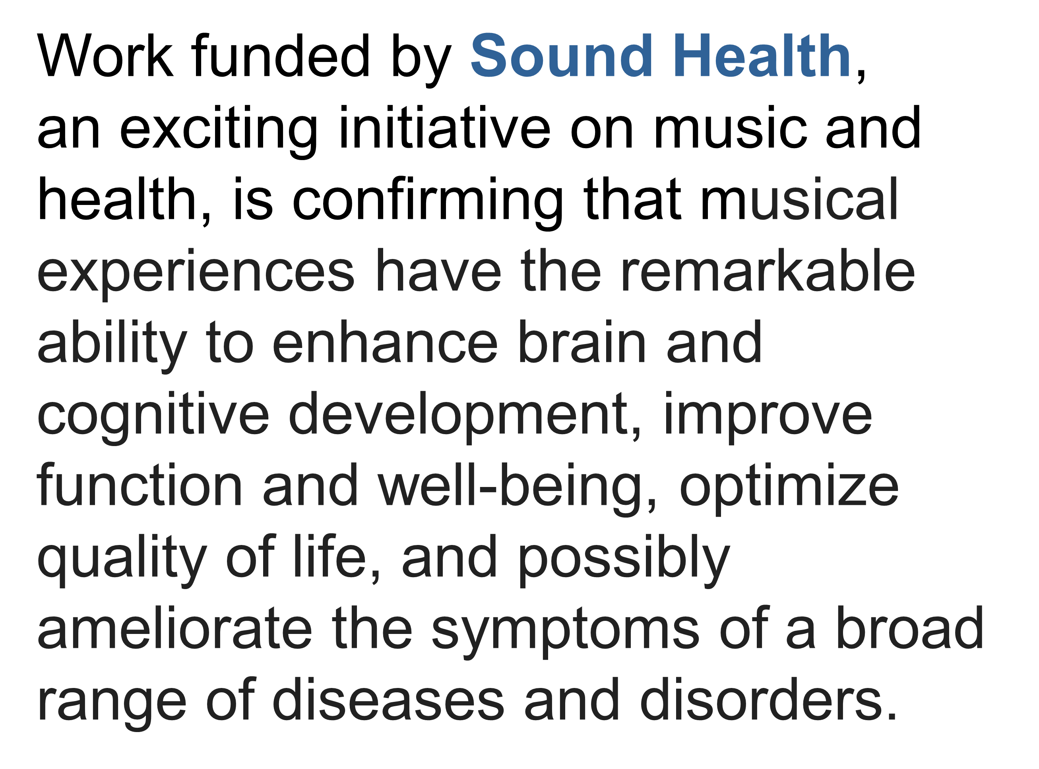

Slide 20


Slide 21
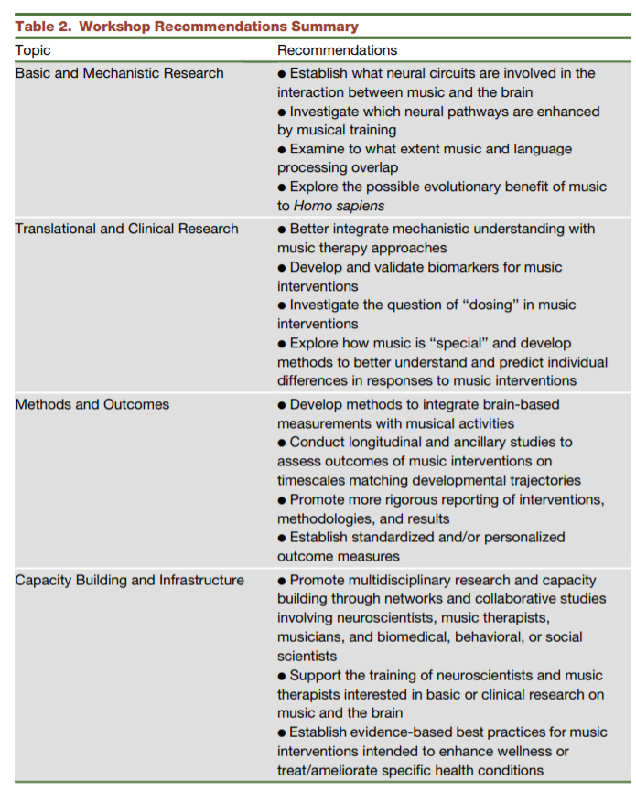

2017 NIH/Kennedy Center Workshop on Music and the Brain: Finding Harmony
Cheever, et al., 2018, Neuron, 97(6): 1214-1218

Slide 22


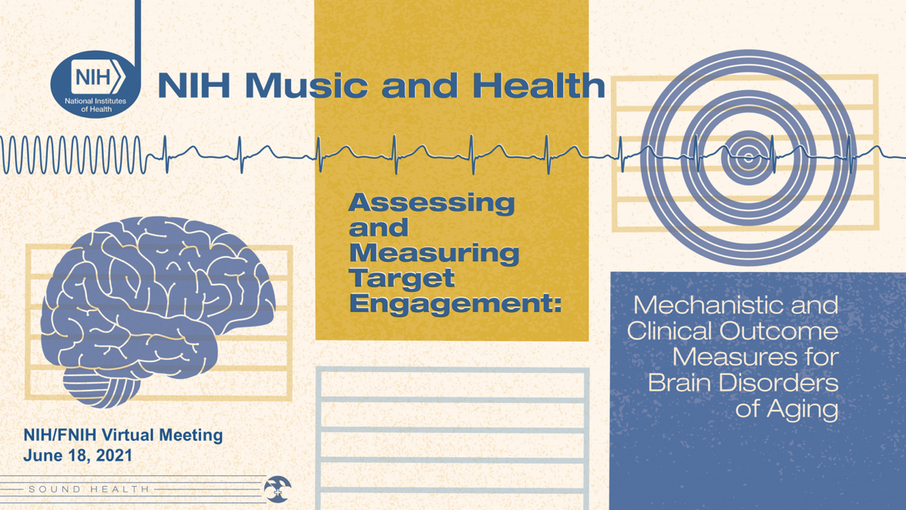
NIH Music-Based Interventions Toolkit,
Edwards E, et al., 2023, Neurology

Slide 23

The NIH Music-Based Interventions Toolkit
Music-Based Interventions for Brain Disorders of Aging
A Web Resource for Music and Health Researchers
https://www.nccih.nih.gov/research/the-nih-music-based-intervention-toolkit

Slide 24

Conceptual Models or Frameworks for Music-Based Interventions
Experimental Medicine Framework
Music Therapy Framework
Neuro-mechanistic Framework
Resilience Framework

Slide 25

Research Question and Supporting Data for MBI Hypothesis Testing
Evidence from prior studies
  Basic research to inform selection of theoretical models
  Translational and clinical research
  Musical elements of intervention
Extant Literature
  Scoping reviews
  Systematic reviews
Clinical Practice
  Music therapy
  Music medicine

Slide 26

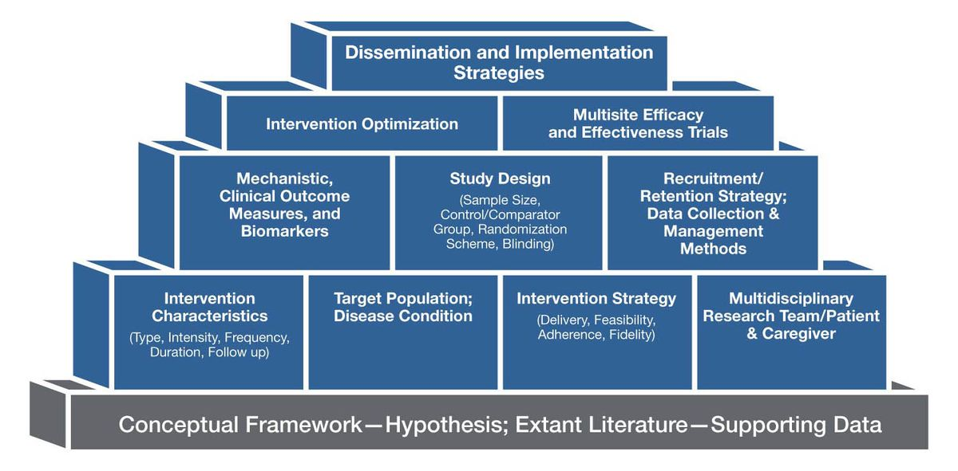
Music-Based Intervention Building Blocks and Common Data Elements

Slide 27
NIH MBI Toolkit & Reporting Guidelines
NIH MBI toolkit focuses on HOW TO design and implement a music-based intervention (MBI) that conforms with the NIH policy for rigor and reproducibility: https://grants.nih.gov/policy-and-compliance/policy-topics/reproducibility
MBI reporting guidelines focus on HOW TO improve transparency and reporting quality of published research
Both are essential for advances in MBI scientific research and translation of findings to practice
Notes:
The NIH strives to exemplify and promote the highest level of scientific integrity, public accountability, and social responsibility in the conduct of science. The application of rigor ensures robust and unbiased experimental design, methodology, analysis, interpretation, and reporting of results.
When a result can be reproduced by multiple scientists, it validates the original results and readiness to progress to the next phase of research. This is especially important for clinical trials in humans, which are built on studies that have demonstrated a particular effect or outcome.
Reporting guidelines are a simple, structured tool for health researchers to use while
writing manuscripts, which provides a minimum list of information needed to ensure a published
manuscript can be understood by a reader, replicated by a researcher, used to inform clinical
decisions, and included in systematic reviews – EQUATOR NETWORK; TIDieR (template for intervention description and replication checklist)

Slide 29
Emmeline Edwards, Ph.D.
emmeline.edwards@nih.gov

Slide 30

2025 Integrative Medicine and Health (IMH) Conference
Seattle, Washington
Health Research Reporting Guidelines and their Extensions
David Riley MD
2437 NW Overton Street
Portland, Oregon 97210
dsrileymd@me.com 505 690-0688

Slide 31

WHY Health Research Reporting Guidelines?
The FDA (Food and Drug Act) was created in 1906.
Adverse events (e.g. related to cough syrup and thalidomide) may stimulate the approval process.
1962 Kefauver Harris amendment formalized a preapproval process for safety and efficacy.
Health research reporting guidelines and their extensions began to emerge in the 1990s.

Slide 32
Clinical Health Research Reporting Guidelines
CONSORT – controlled clinical trial guidelines (1996)
STROBE – observational study guidelines (2007)
PRISMA – systematic review and meta-analysis guidelines (2009)
CARE – case report guidelines (2013)
Most clinical guidelines have extensions (e.g. TIDIER, STRICTA, music)

Slide 33
Individual vs. Population Research
Effectiveness versus Efficacy
Case Reports may establish effectiveness and safety in the treatment of individuals.
Controlled Clinical Trials may establish efficacy and safety in populations.

Slide 34
Clinical Research Challenges
Can the results from case reports be generalized to populations?
Can the results from populations be generalized to individuals?

Slide 35
Risk of Bias
Bias is ALWAYS present. It becomes a risk when it is not acknowledged or discussed. (Cochrane has a “risk of bias” tool.)

Slide 36
Evidence-based Medicine
“
The practice of evidence-based medicine means integrating individual clinical expertise and the best available external clinical evidence from systematic research… with patient preference.
”
David Sackett, British Medical Journal editorial - 1996

Slide 37
Evidence-Based Medicine (EBM)
Evidence-based Medicine Hierarchy
Meta-Analyses,
Systematic Reviews
Observational Studies
cohort, case-control, cross-sectional
Case Reports and Case Series
Historic Use, Expert Opinion
Randomized Controlled Trials
Applicable Guidelines
PRISMA
CONSORT
STROBE
CARE

Slide 38
IMH Research
Formal clinical research and the development of evidence is often
funded by patent protection related to synthetic pharmaceuticals.
          Systematic clinical research in IMH following health research reporting guidelines and their extensions (eg TIDIER, STRICTA, music), support the development of accurate, transparent, and reproducible evidence for IMH as well as support additional clinical research.

Slide 39


IMH publications
The number of published IMH articles in indexed scientific journals has increased over the past 30 years.
Global Advances,
Journal of Integrative & Complementary Medicine,
Alternative Therapies in Health & Medicine
Medline indexed journals: e.g. Global Advances, the Journal of Integrative and Complementary Medicine, and Alternative Therapies in Health and Medicine focus on IMH.

Slide 40
Preprints
Preprints have become a first step in the publication of scientific information in healthcare over the past several years.
Preprints | Journal Articles
Not peer-reviewed | Peer reviewed
Under author control | Under journal control
Posted on preprint servers | Published in scientific journals

Slide 41
Opportunities for IMH
Evidence-based research (following guidelines) presented at conferences or posted on preprint servers and published in scientific journals; offers evidence for the effectiveness and safety of IMH that may stimulate clinical research, as well as improve clinical training and expertise.

Slide 42


A Journal Perspective on
Reporting Guidelines
Erik J. Groessl, PhD
Co-Editor in Chief
Global Advances in Integrative Medicine and Health
UC San Diego School of Public Health
VA San Diego Healthcare System

Slide 43

Background
Dr. Rick Hecht and I are Co-Editors of Global Advances in Integrative Medicine and Health
Global Advances is the official journal of the ACIMH
“further develop the evidence base of the latest knowledge of basic/translational, clinical, and epidemiological research on integrative medicine and health.”
Published multiple music interventions manuscripts in 2024
Notes:
Before I start, I want to say that I agree with what's been said so far. I think reporting guidelines can improve the quality and pace of research by promoting transparency, replicability, and by educating researchers about the importance of things they might miss or not report on. They could be perceived as restrictive, but they are just guidelines and they allow for flexibility and creativity as long as explanations are provided.
I should add that we will be publishing the music guidelines as a secondary journal and we have published other reporting guidelines in the past.

Slide 44
Challenges
Encouraging submissions
Finding peer reviewers
Resolving disparate and variable peer reviews
Time to decision and publication
_____________________________________
May be perceived as making submissions harder
May be perceived as making peer review or editorial process harder
Notes:
Some of the challenges we face in publishing science are…
I should qualify this by saying that every journal is a little different. I cannot speak for large well-established journals, but this does apply to most IMH journals.

Slide 45
Reporting Guidelines
Cue or require authors to include important information
Cue or require authors to address missing items as limitations
Cues peer reviewers and editorial team to focus on these basic and important items
Notes:
I think…

Slide 46
Journal Perspective
Should only take authors 10-15 minutes - unless?
May make a reviewer’s job easier, not harder
Improves the consistency and reliability of the review process.
Promotes transparency, allows replication, better quality
Is expected to shorten the time to publication period by requiring fewer total revisions
Notes:
Unless their study is lacking in some area

Slide 47
Guidelines
Randomized trials | CONSORT
Observational studies | STROBE
Systematic reviews | PRISMA
Study protocols | SPIRIT
Diagnostic/prognostic studies | STARD
Case reports | CARE
Clinical practice guidelines | AGREE
Qualitative research | SRQR
Animal pre-clinical studies | ARRIVE
Quality improvement studies | SQUIRE
Economic evaluations | CHEERS
Notes:
The EQUATOR network lists 11 main reporting guidelines but most benefit from extensions, like music therapy guidelines, that are intervention or disease specific

Slide 48
GAIMH current policy
We used to not mention reporting guidelines at all
Statements at submission….
1. I have followed recommended guidelines for my article, such as CONSORT Statement guidelines, STROBE or PRISMA checklists and others. __X__
2. My article does not require adherence to a specific guideline or checklist because: _________________________________________
Moving toward requiring checklists for main guidelines and recommending extensions.
We strongly support the use of research reporting guidelines!
Notes:
Unless their study is lacking in some area

Slide 49

Thank You!

